Slide 1
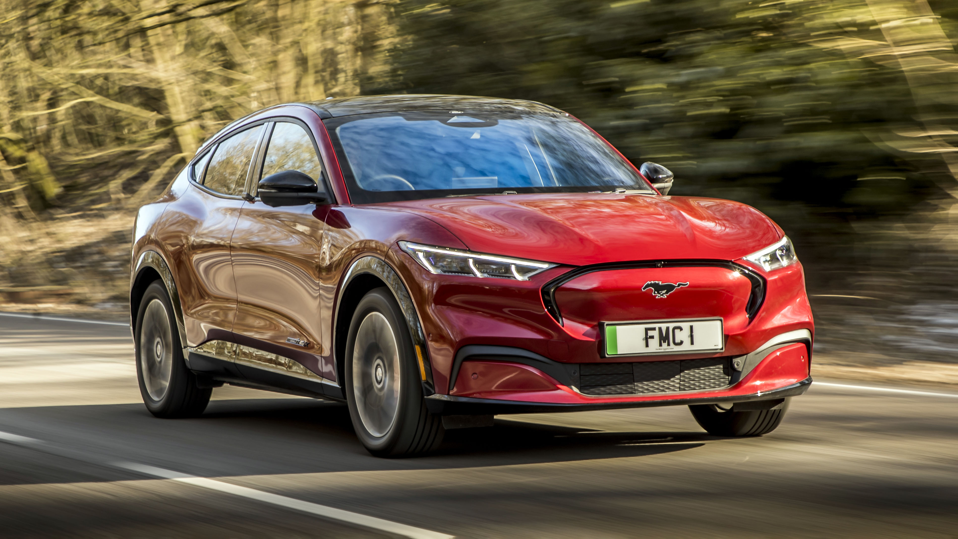
ElectriCars Go Green
Ali Haider Khan
12001018 | 3CE1​

Slide 2
INTRODUCTION
Python:
Data Science:
Python is a high-level, interpreted, general-purpose programming language. Its design philosophy emphasizes code readability with the use of significant indentation. Python programming language (latest Python 3) is being used in web development, Machine Learning applications, along with all cutting-edge technology in Software Industry. [1]
Data science is an interdisciplinary field that uses scientific methods, processes, algorithms and systems to extract or extrapolate knowledge and insights from data and apply knowledge from data across a broad range of application domains. Data science is related to data mining, machine learning and big data. [2][3]

Slide 3
Machine Learning:
Machine Learning is the field of study that gives computers the capability to learn without being explicitly programmed. ML is one of the most exciting technologies that one would have ever come across. [1][2]
Supervised
Unsupervised
Contains both input (features) and output (target) columns.
Contains only input (features) columns.
Semi-Supervised
Reinforcement
Mix of both supervised and unsupervised data.
Differs from supervised learning in not needing labelled input/output pairs be presented, and in not needing sub-optimal actions to be explicitly corrected.

Slide 4
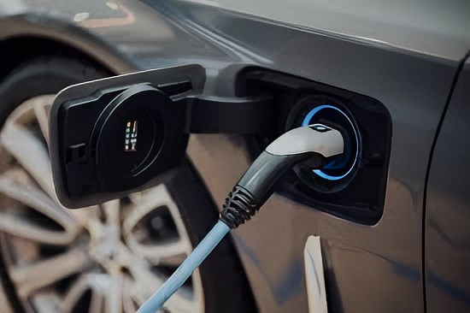
ABOUT PROJECT
AIM:
To train a machine learning model with an ‘Electric Cars’ dataset and implement it in a website which predicts the prices of electric cars, according to their specifications entered by the user.
To give users various options to see different kinds of statistics related to Electric Cars.
PREREQUISITE:
Knowledge of Pandas and its relevant libraries, Data cleaning, Data visualization, Machine learning and its various models, etc.

Slide 5
TOOLS USED
PYTHON
NumPy, Pandas, Matplotlib, Seaborn, Sklearn, Pickle
Model Used: DecisionTreeRegressor
FLASK
CSS
HTML
JAVASCRIPT
BOOTSTRAP

Slide 6
DFDs
Backend:
CSV File
(ElectricCarData_Clean_Me.csv)
Reading
Python DataFrame (df)
Analysis
Data pre-processing and cleaning.
Cleaned Data
Visual representation of various statistics.

Slide 7
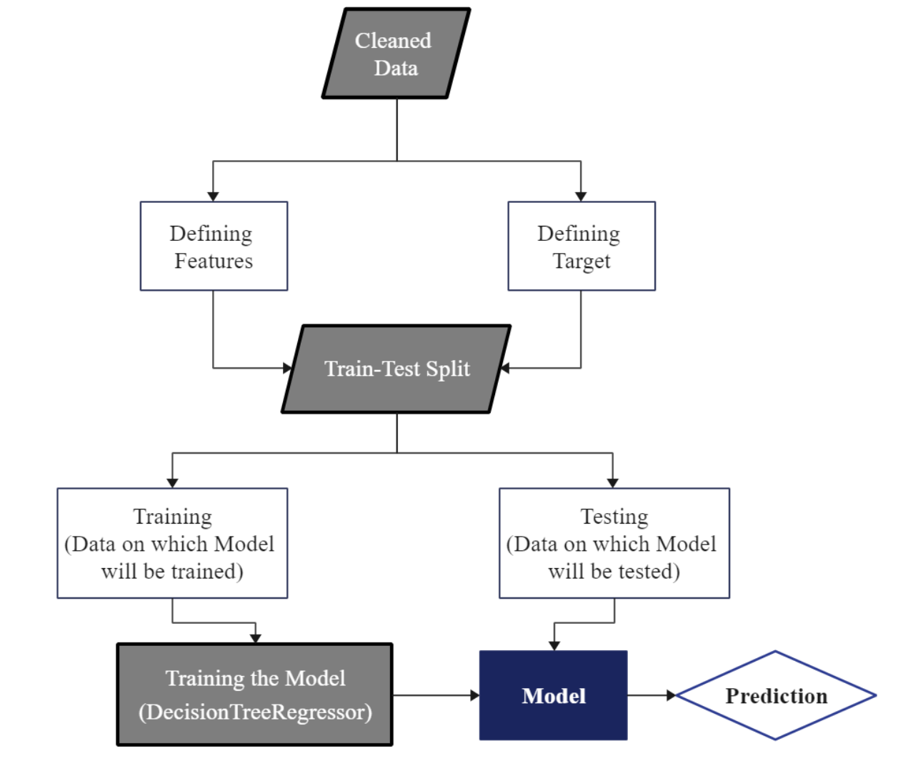
Machine
Learning:

Slide 8
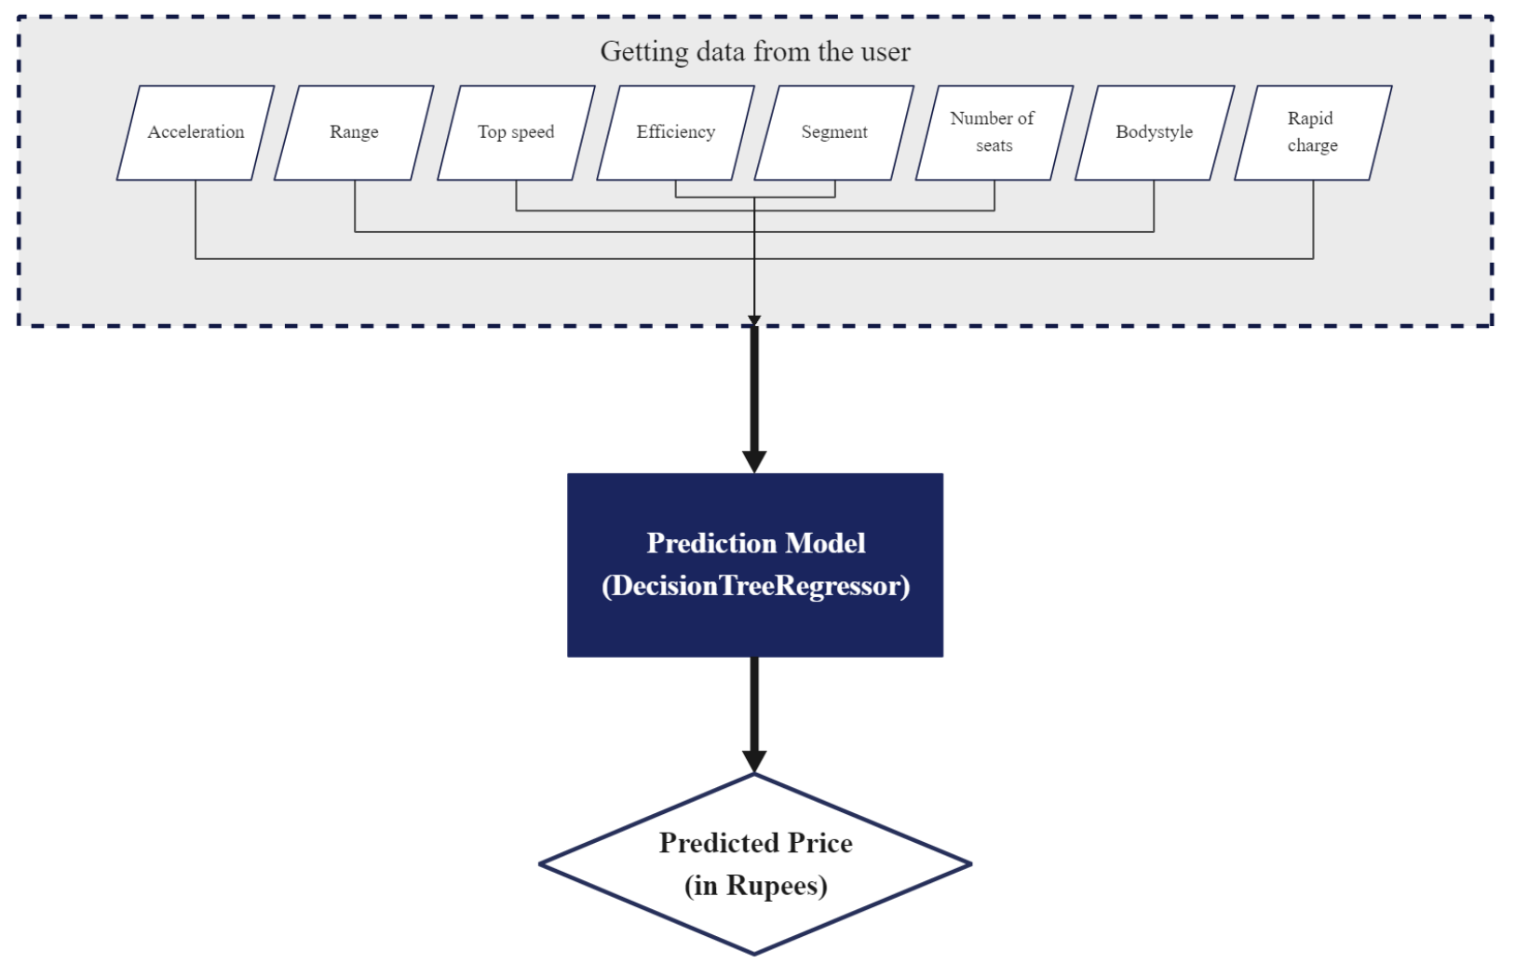
Frontend:

Slide 9
PREDICTION
Models used: Accuracy Achieved :
DecisionTreeRegressor 97-99%
DecisionTreeRegressor is a non-parametric supervised learning
method used for classification and regression. The goal is to create
a model that predicts the value of a target variable by learning simple
decision rules inferred from the data features.
LinearRegression 93%

Slide 10
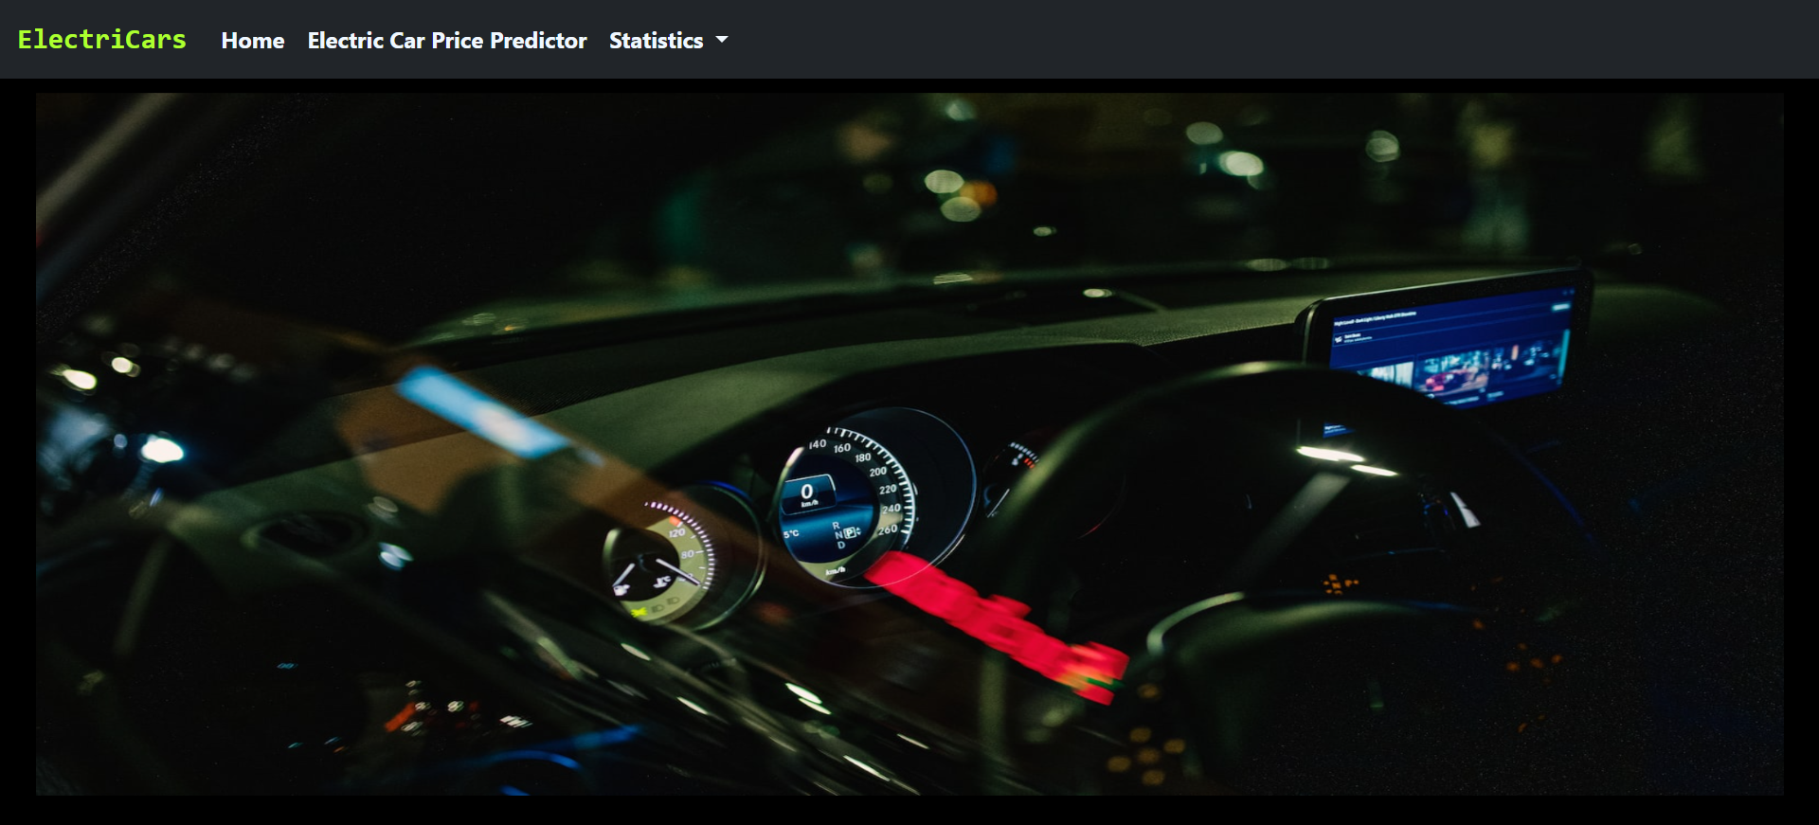
INTERFACE
HOME:

Slide 11
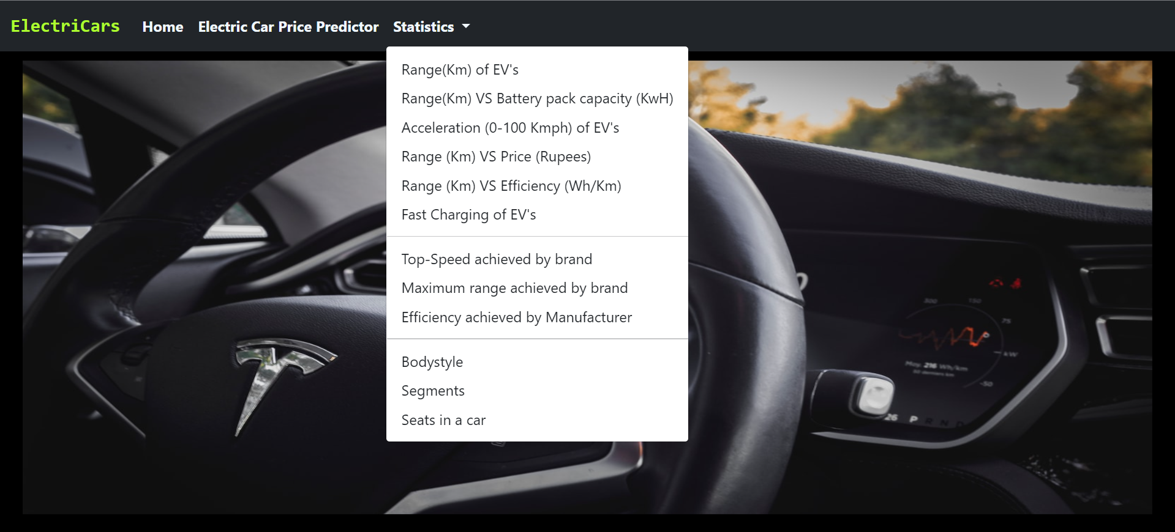
STATISTICS:

Slide 12
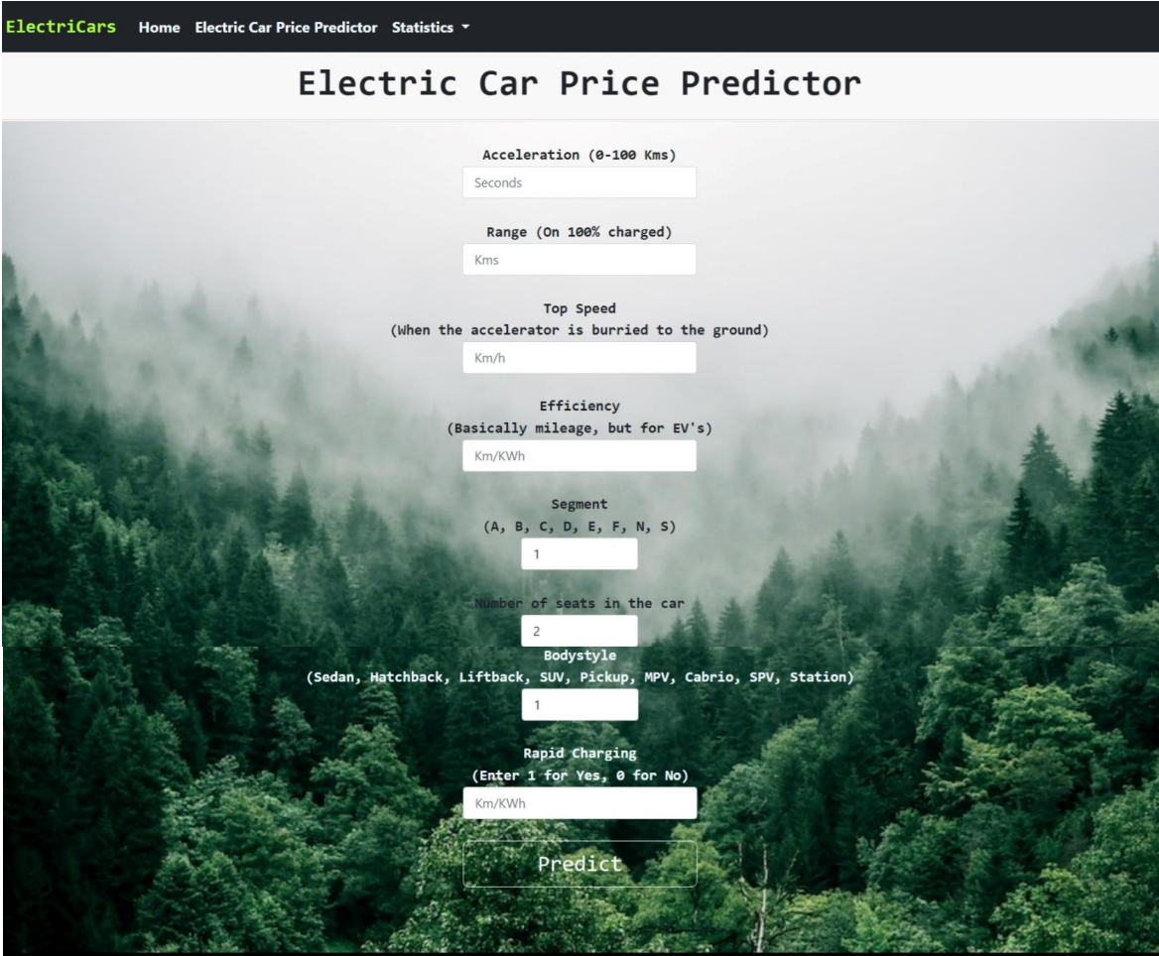
Electric Car Price Predictor:

Slide 13
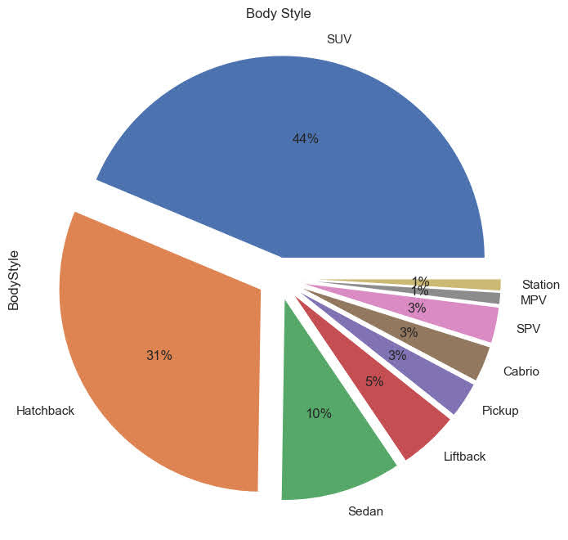
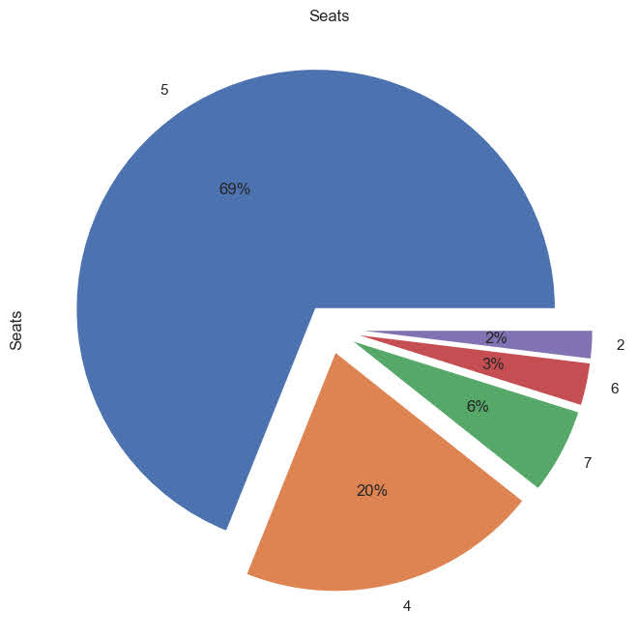
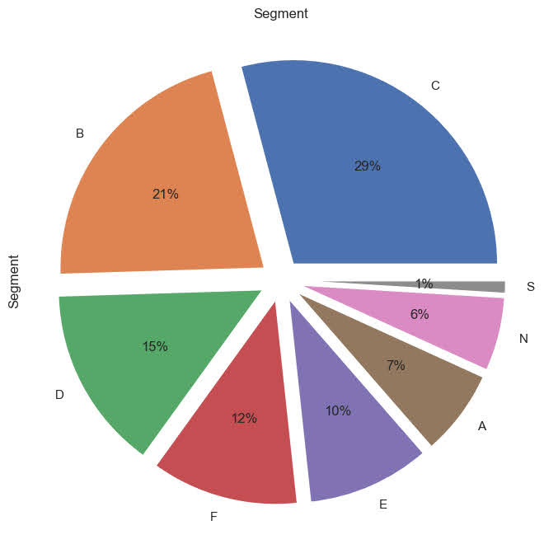
ANALYSIS
BODY STYLE
SEATS
SEGMENTS
44% SUVs
31% Hatchbacks
10% Sedans
5% Liftback
3% Pickup, Cabrio and SPVs
1% MPV and Stations
69% 5 seaters
20% 4 seaters
6% 7 seaters
3% 6 seaters
2% 2 seaters
29% C, 21% B
15% D, 12% F
10% E, 7% A
6%N, 1% S

Slide 14
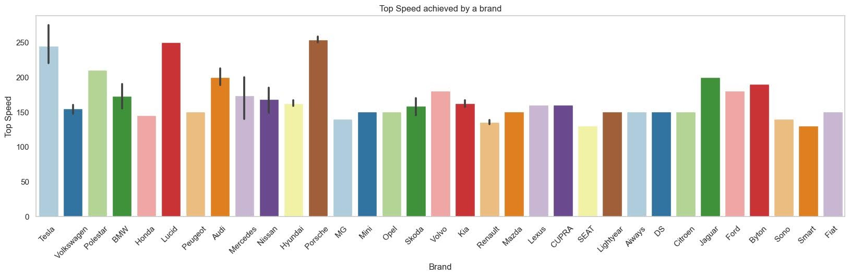
ANALYSIS (BAR GRAPHS)
Top speed Achieved by Brands:

Slide 15
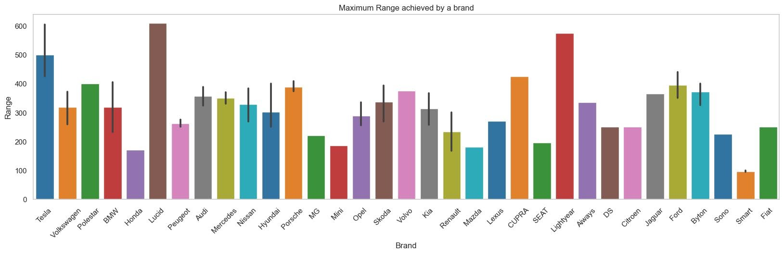
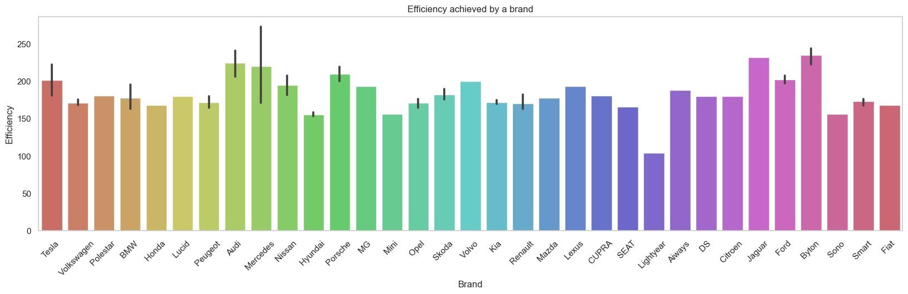
Maximum Range Achieved:
Maximum Efficiency
Achieved:

Slide 16
FUTURE-SCOPE More refining of this project could be done to make it industry ready. Further improvement will ensure the accuracy and efficiency. More features could be added to the website which may make the website more informative to its user. Future scope of this project is its implementation in the market of electric cars. The project is open for further improvements.
CONCLUSION Electric cars are the future of motor car industry. ‘ElectriCars’ is developed with the intend of helping its users with the price prediction of electric cars. The website is quite easy to use and it is equipped with ‘Electric Car Price Predictor’ and ‘Statistics’ sections, which opens up new webpage where the user can enter desired details (specifications) about vehicle and have various options for the visual representation of data related to electric cars, respectively.

Slide 17

Thank you.
Ali Haider Khan
12001018 | 3CE1
14-10-2022

